Slide 1



Software Architecture
Architecture Design

Slide 2

Strategy requires thought, tactics require observation
Max Euwe
World Chess Champion
(1935-1937)

Slide 3
Architecture Design
Architectural Tactics

Slide 4
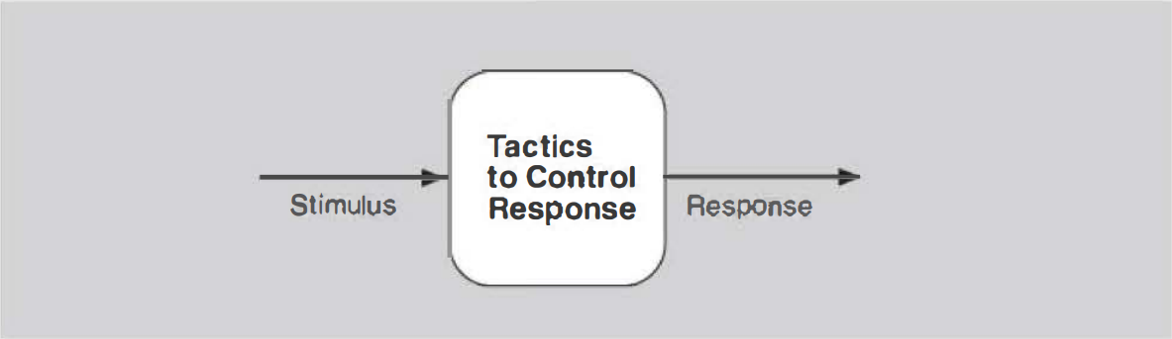
Architectural Tactics
A tactic is a design decision that influences the achievement of a quality attribute response

Slide 5

Architectural Tactics
Architectural styles define types of components and connectors in specified topology that are useful for structuring an application logically or physically.
Architectural/design patterns are conceptual solutions for recurring problems
Tactics are design decisions that influence the control of a quality attribute response
Notes:
Architecture styles are often mixed up with architecture patterns – they often refer to the same thing
The tactics are the blocks for the Architectural Patterns

Slide 6
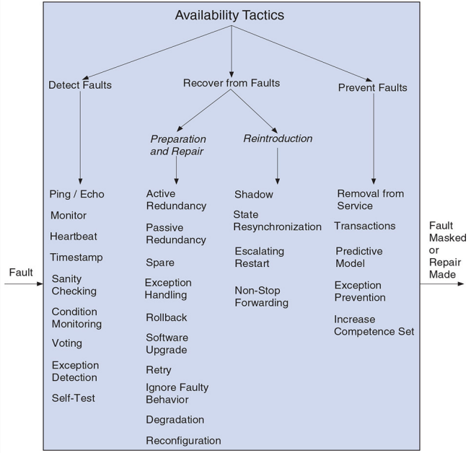
Architectural Tactics
Notes:
https://people.ece.ubc.ca/matei/EECE417/BASS/ch05lev1sec2.html

Slide 7
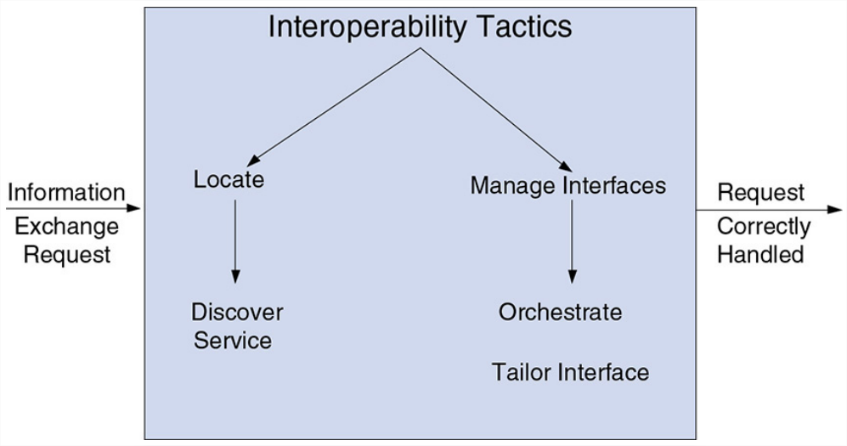
Architectural Tactics

Slide 8
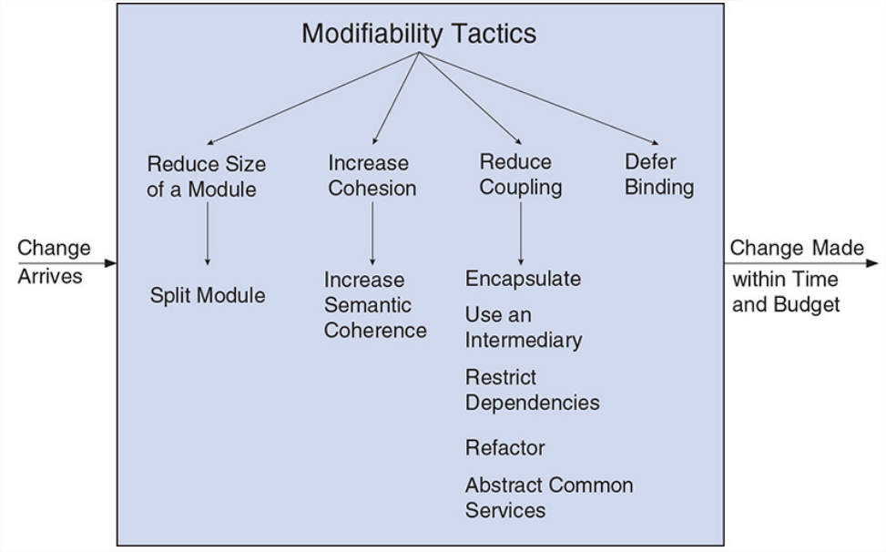
Architectural Tactics
Notes:
https://people.ece.ubc.ca/matei/EECE417/BASS/ch05lev1sec3.html

Slide 9
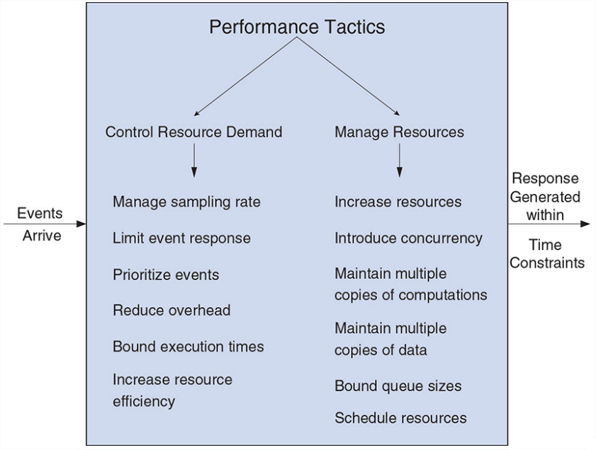
Architectural Tactics
Performance Tactics
Notes:
https://people.ece.ubc.ca/matei/EECE417/BASS/ch05lev1sec4.html

Slide 10
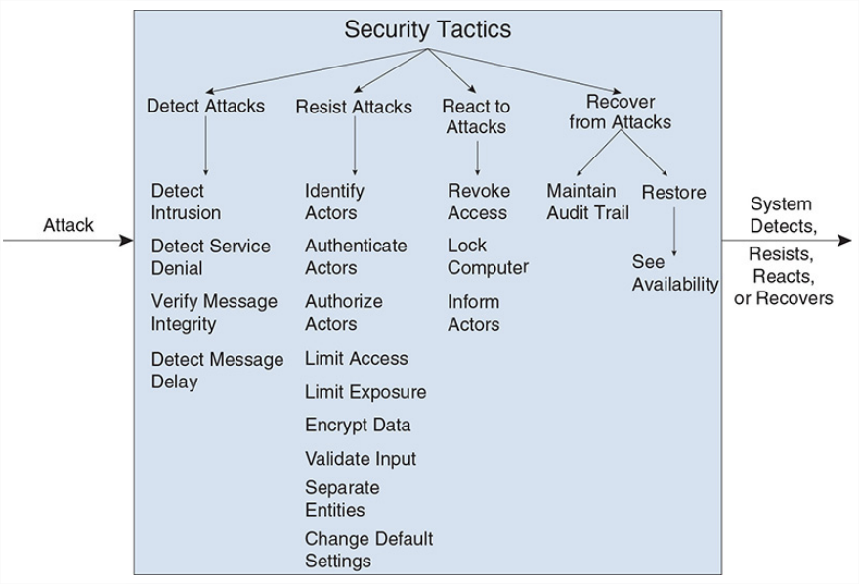
Architectural Tactics
Security Tactics
Notes:
https://people.ece.ubc.ca/matei/EECE417/BASS/ch05lev1sec5.html

Slide 11
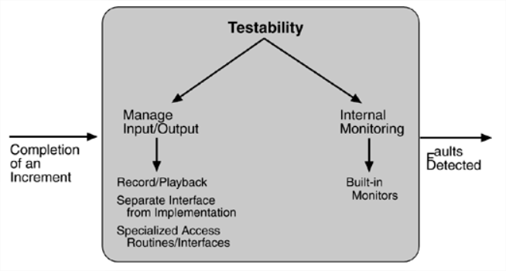
Architectural Tactics
Notes:
https://people.ece.ubc.ca/matei/EECE417/BASS/ch05lev1sec6.html

Slide 12
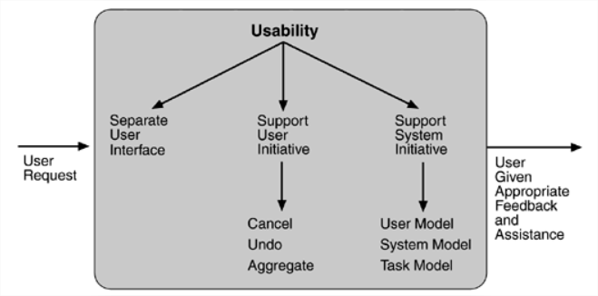
Architectural Tactics

Slide 13
Architecture Design
Architectural Patterns

Slide 14

The software architecture patterns are the cornerstones that uphold the sturdiest technological structures. They are like the invisible laws that govern the world of software, providing proven and efficient solutions to recurring problems. By mastering these patterns, software architects can build robust and flexible systems that will endure over time
Martin Fowler

Slide 15
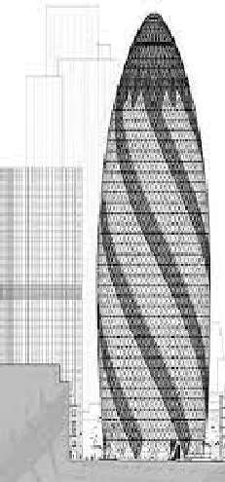
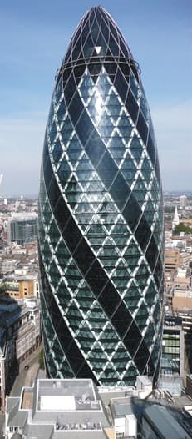
Architectural Patterns
An architectural pattern is a general, reusable solution to a commonly occurring problem in software architecture within a given context.
Architectural patterns are similar to software design pattern but have a broader scope.

Slide 16
Architectural Patterns
An architectural pattern establishes a relationship between:
A context. A recurring, common situation in the world that gives rise to a problem.
A problem. The problem, appropriately generalized, that arises in the given context. The pattern description outlines the problem and its variants, and describes any complementary or opposing forces. The description of the problem often includes quality attributes that must be met.
A solution. A successful architectural resolution to the problem, appropriately abstracted. The solution describes the architectural structures that solve the problem, including how to balance the many forces at work. The solution will define the responsibilities of and static relationships among elements (using a module structure) or describe the runtime behavior of and interaction between elements (laying out a component-and-connector or allocation structure).
Notes:
An architectural pattern establishes a relationship between:
A context. A recurring, common situation in the world that gives rise to a problem.
A problem. The problem, appropriately generalized, that arises in the given context. The pattern description outlines the problem and its variants, and describes any complementary or opposing forces. The description of the problem often includes quality attributes that must be met.
A solution. A successful architectural resolution to the problem, appropriately abstracted. The solution describes the architectural structures that solve the problem, including how to balance the many forces at work. The solution will describe the responsibilities of and static relationships atnong elements (using a module structure), or it will describe the runtitne behavior of and interaction between eletnents (laying out a component-and-connector or allocation structure). The solution for a pattern is determined and described by:
A set of element types (for example, data repositories, processes, and objects)
A set of interaction mechanisms or connectors (for example, method calls, events, or message bus)
A topological layout of the components
A set of semantic constraints covering topology, element behavior, and interaction mechanisms
The solution description should also make clear what quality attributes are provided by the static and runtime configurations of elements.
This {context, problem, solution} form constitutes a template for documenting a pattern.
Complex systems exhibit multiple patterns at once. A web-based system might employ a three-tier client-server architectural pattern, but within this pattern it might also use replication (mirroring), proxies, caches, firewalls, MVC, and so forth, each of which may employ more patterns and tactics. And all of these parts of the client-server pattern likely employ layering to internally structure their software modules.

Slide 17
Architectural Patterns
Common Architectural Patterns
Layered pattern
Client-server pattern
Master-slave pattern
Pipe-filter pattern
Broker pattern
Peer-to-peer pattern
Event-Driven pattern
Model-view-controller pattern
Blackboard pattern
Interpreter pattern
Microkernel Pattern
Microservices Pattern

Slide 18
Architectural Patterns
Common Architectural Patterns
Layered pattern
Context:
Problem:
Solution:
IMAGE HERE

